Slide 1
Top Down Approach
Try to my best, become better everyday

Slide 2
Table of contents
01
02
03
What’s Top Down Approach?
Why we use Top Down Approach
How to apply it on assigment

Slide 3
What’s Top Down Approach
01

Slide 4
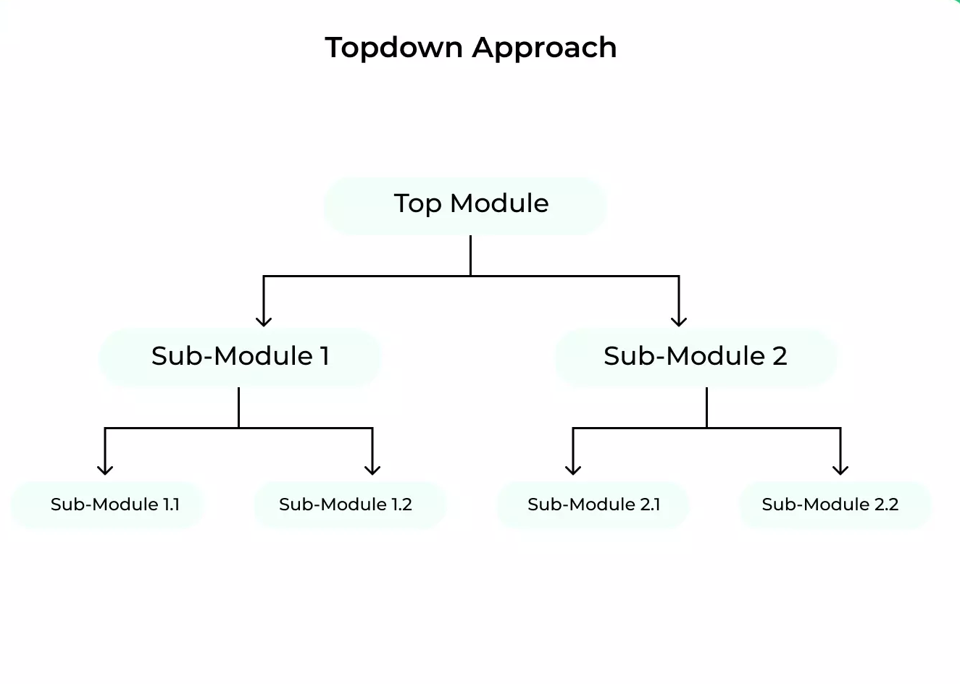
What’s Top Down Approach?
In software development is a method of designing and building a system.
By breaking down a large, complex problem or system into smaller, more manageable pieces and then working on each piece individually.

Slide 5
Why we use Top Down Approach
02

Slide 6
Why we use Top Down Approach?
Broad Overview
Division of Work
You have an overview of the system, easily understanding what a system has
A system is broken down, it is great for dividing up work.

Slide 7
Why we use Top Down Approach?
Teamwork
Quality
Problem Simplification
Breaking problems into parts helps identify what needs to be done.
Breaking problems into parts allows more than one person to solve the problem
No room for mistakes in implementing user requirements. High quality can be achieved.

Slide 8
03
How to
apply it?

Slide 9
How to apply it on my assignment?
01
02
03
04
05
Understand the problems(system).
Identify subproblems(subsystems)
Ask question related to subproblems(subsystems)
Choose the most important subproblems(subsystems)
Resolve according to priority

Slide 10
Example
1. Understand
Top Down Approach & How to apply it?
2. Identify
Top Down Approach
How to apply it
3. Priority

Slide 11
Example
4. Ask question
Top Down Approach
What
Why
How
5.Resolving

Slide 12
Thanks!

